Slide 1



Introduction to Perfume E-Commerce Dataset 2024
This dataset provides comprehensive insights into the perfume e-commerce industry, encompassing diverse aspects such as customer demographics, purchasing behavior, product features, and marketing strategies.
by bharathi bk
bb

Slide 2
Data Exploration and Preprocessing
This step involves loading and examining the dataset to gain an understanding of its structure, identify missing values, and handle any data inconsistencies or errors.
Data Loading
Data Cleaning
Data Transformation
Utilize Pandas to load the dataset from a CSV or other compatible format.
Handle missing values, remove duplicates, and address inconsistent data entries.
Convert data types, encode categorical variables, and apply necessary transformations.

Slide 3

Exploratory Data Analysis
This involves exploring the data to discover patterns, relationships, and insights that can inform subsequent modeling decisions.
Descriptive Statistics
1
Calculate basic summary statistics for each variable to understand central tendencies and distributions.
2
Visualization
Use various plots, such as histograms, scatter plots, and box plots, to visualize data patterns and relationships.
Hypothesis Testing
3
Conduct statistical tests to validate hypotheses about relationships between variables.

Slide 4
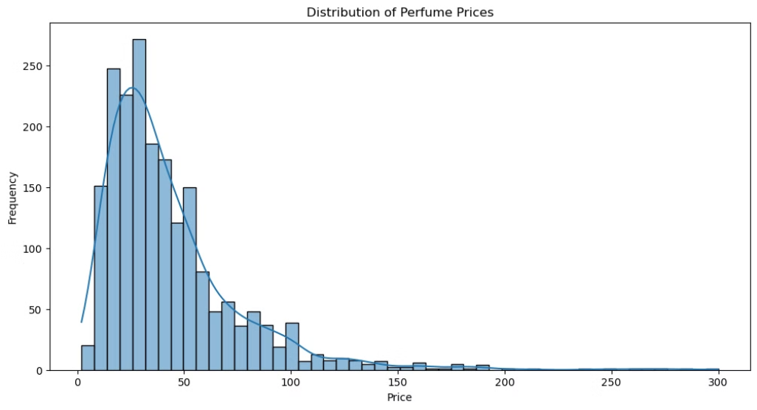
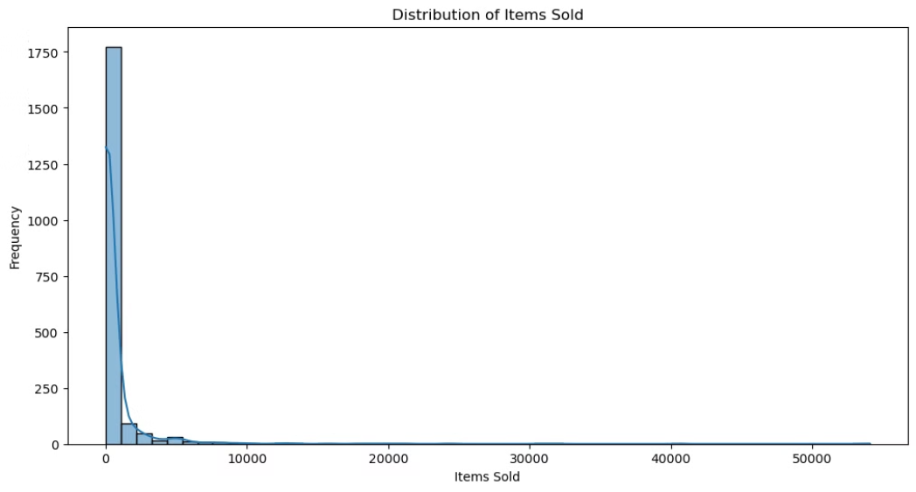
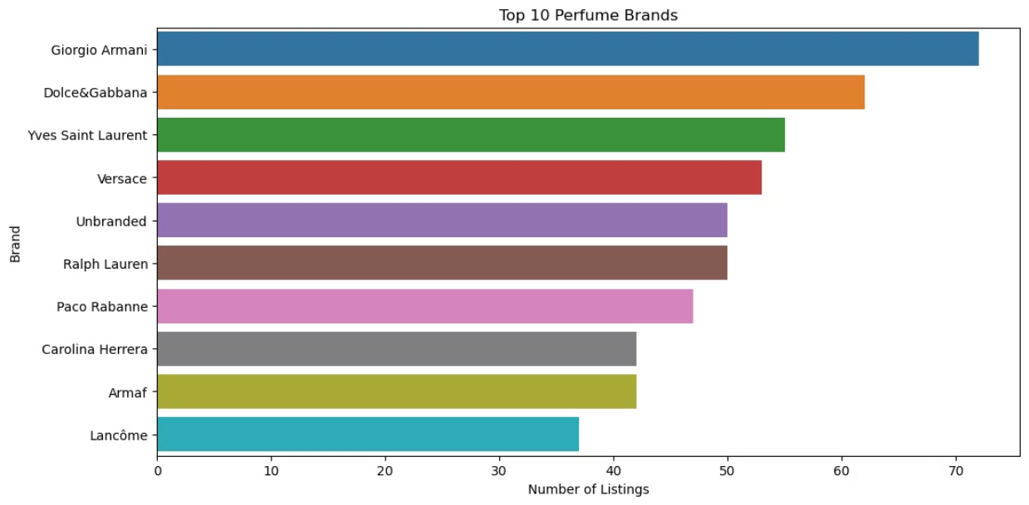
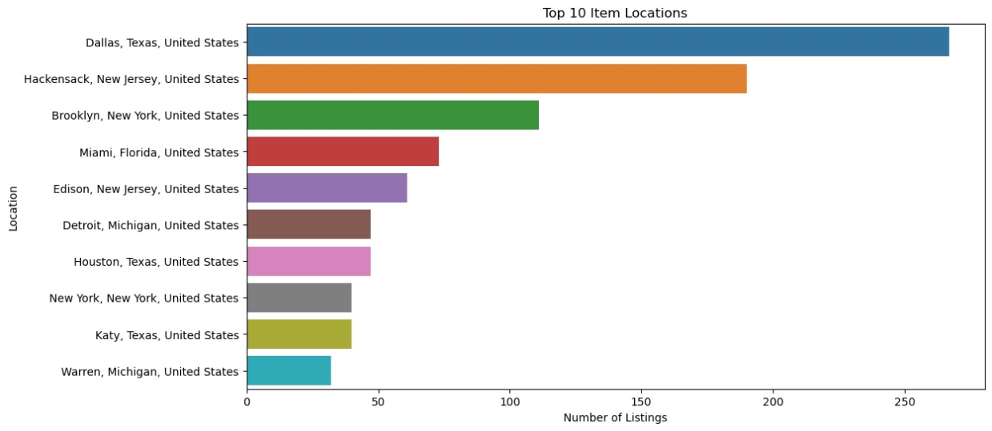
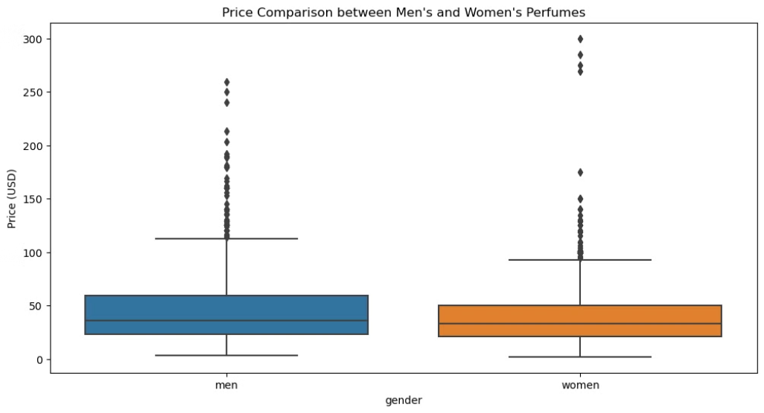
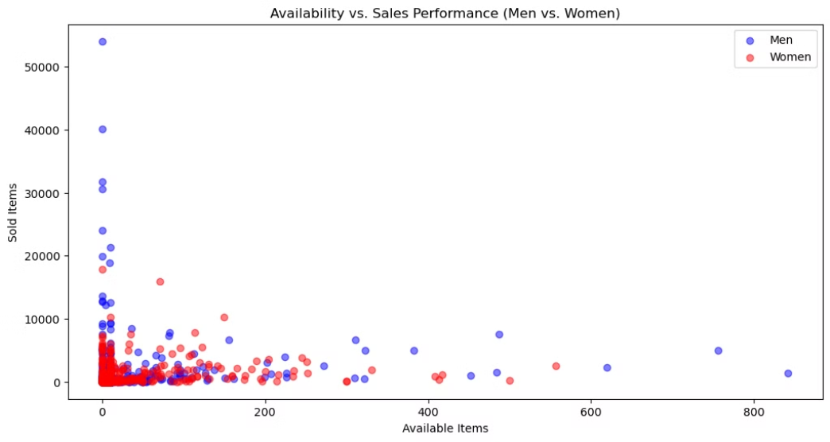
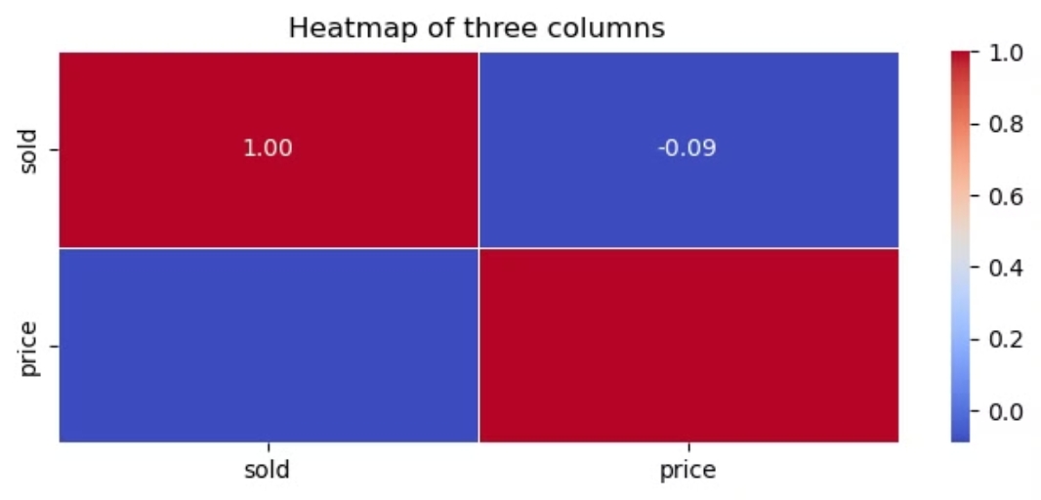
Visualizing Insights and Trends
1. Distribution of prices
The rise of frequency inthe range of 0 to 50
we can conclude that the rise of prices leads to low sales
2.Sales trends
The frequency of the items sold reached the top record, but drastically comes down quickly
The entire items sold range below 10000
3.Brand popularity
This plot shows the result of top 10 perfume brands
In this giorgio Armani holds the top spot
And the 10th spot hold by lancome
4.Geographical distribution of listing
In this plot we can easily understand that the Dallas Texas recorded large number listing
The Warren , Detroit , newyork ,katy has lowest of below 50 listings
Comparison of Men's and Women's Perfumes
1. Price Analysis
The boxplot compares the prices of men's and women's perfumes.
Both categories have similar median prices.
Men's perfumes show a slightly wider range of prices, with a few higher-priced outliers
2. Availability and Sales Performance
Average Availability (Men): 17.82
Average Availability (Women): 18.62
Average Sold (Men): 761.67
Average Sold (Women): 489.36
The scatter plot differentiates between men's and women's perfumes.
Both categories show similar patterns in the relationship between availability and sales.
There are a few high-sale outliers in both categories, with men's perfumes showing slightly more variability.
4. Location Analysis
Top Locations for Men's Perfumes:
itemLocation
Dallas, Texas, United States 126
Hackensack, New Jersey, United States 105
Brooklyn, New York, United States 76
Miami, Florida, United States 41
Edison, New Jersey, United States 35
Houston, Texas, United States 28
Katy, Texas, United States 25
Detroit, Michigan, United States 22
New York, New York, United States 21
Warren, Michigan, United States 14
Name: count, dtype: int64
Top Locations for Women's Perfumes:
itemLocation
Dallas, Texas, United States 141
Hackensack, New Jersey, United States 85
Brooklyn, New York, United States 35
Miami, Florida, United States 32
Edison, New Jersey, United States 26
Detroit, Michigan, United States 25
Las Vegas, Nevada, United States 23
New York, New York, United States 19
Houston, Texas, United States 19
Warren, Michigan, United States 18
Name: count, dtype: int64
Mens perfume location¶
This information is about the levels of perfume in men
More perfumes are available in Texas US 126
There is minimal perfumes available in the Michigan US 14
Womens perfume location¶
This information is about the levels of perfume in women
More perfumes are available in Texas US 141
There is minimal perfumes available in the Michigan US 18
5. HEAT MAP
This Heat map shows that the both price and items are negatively correlated

Slide 5


Conclusion and Future
Our analysis provides insights to guide strategy. We'll leverage analytics and data integration to make accurate predictions, personalize recommendations, and understand the market.
Real-time data processing will help us respond quickly to shifting customer needs, solidifying our position as the leading perfume e-commerce platform.

